Slide 1
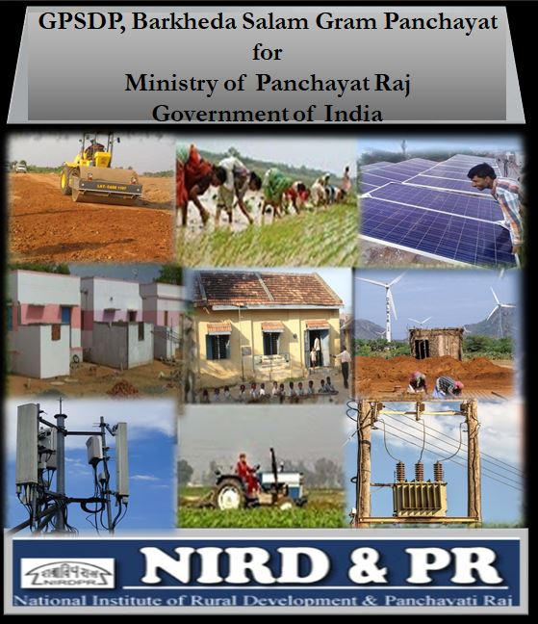
Preparation of Gram Panchayat
Spatial Development Plan (GPSDP)
National Workshop on Experience Sharing under SPMRM on 24th June 2019
Dr. P Kesava Rao
Associate Professor & Head (CGARD)
National Institute of Rural
Development and Panchayat Raj
Hyderabad
A collaborative study with
School of Planning and Architecture, Bhopal.

Slide 2
Preparation of Gram Panchayat Spatial Development Plan (GPSDP)
Plan proposal for short term (5 years) for zoning and efficient land utilisation in the rural areas and a participatory spatial planning for Gram Panchayat.
Identification of Spatial Planning parameters in VDP to be created
Develop a methodology for inclusion of Spatial Planning at Gram Panchayat Level
Implementation process under the statute of 73rd Ammendent

Slide 3
Spatial Attributes
Non Spatial Attributes
Physical features
Socio‐economic data
Land ownership and holding
Social structure
Housing condition
Decision regarding:
1. Land Use/Zoning
Participatory Planning and Decision Making
Physical Infrastructure
2. Housing and Infrastructure
Social Infrastructure
Draft Report – Recommended process flow , data layers, spatial decision and convergence framework

Slide 5
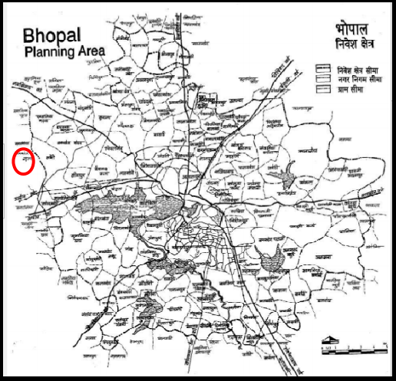
Location of Selected Village
Selected village lies just outside Bhopal Planning Area boundary.
Selected as an example of peri‐urban village.
Need to prioritize such settlements due to proximity to city.

Slide 6
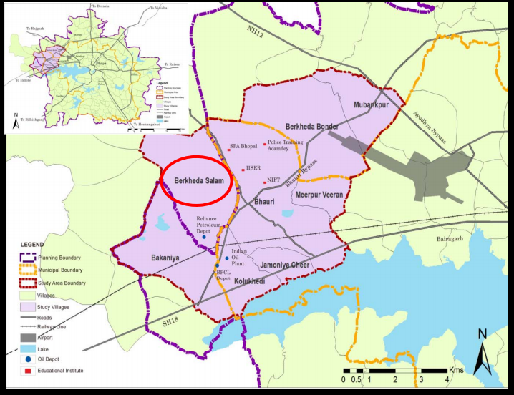
Selected Village and Surrounding Settlements
Planning Boundary
Municipal Boundary
Study Area Boundary
Villages Study Villages
Roads
Railway Line Airport
Lake
Oil Depot
Educational Institute

Slide 7
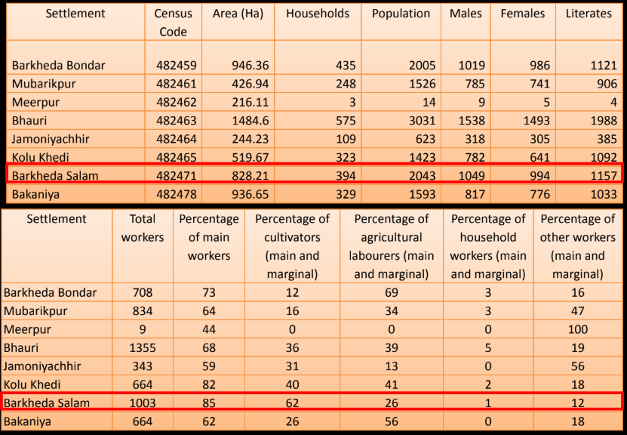
Socio‐Demographic and Socio‐Economic Baseline from Census (Source: Census, 2011)

Slide 8
Land Classification as per Census (Source: Census, 2011)

Slide 10
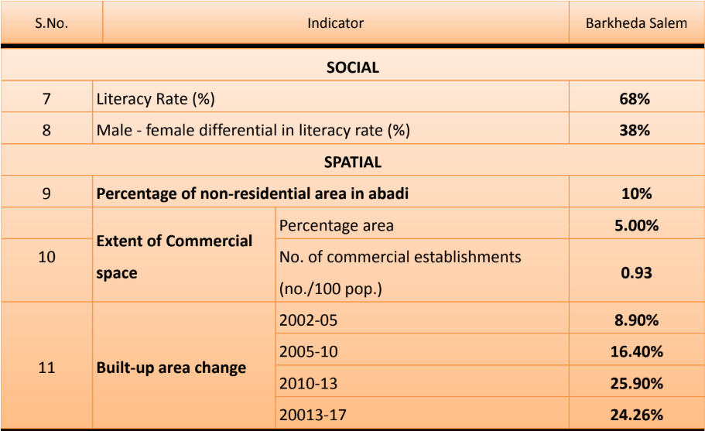

Slide 12
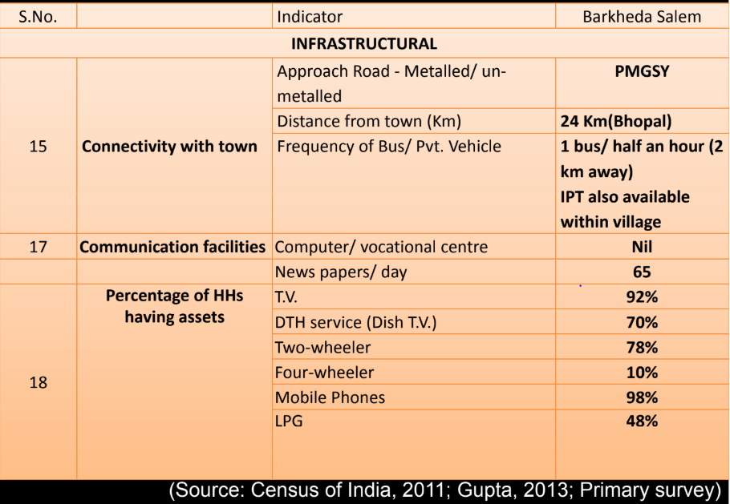

Slide 13
Existing Framework For Village Planning
Government of Madhya Pradesh passed the Panchayat Adhiniyam 1993 which provides Panchayat for villages, Janpad Panchayats for blocks and District Panchayat for district.
Barkheda Salam GP has single Revenue Village and falls under Phanda Janpad Panchayat within Bhopal Zilla Panchayat.
The village lies outside Bhopal Planning Area and as such, the provisions of the Madhya Pradesh Nagar Tatha Gram Nivesh Adhiniyam do not apply to it.
As per Section 7 of the Madhya Pradesh Panchayat Raj Avam Gram Swaraj Adhiniyam, 1993, Gram Sabha has the power to approve all plans including Annual Plans, programmes and projects for social and economic development.

Slide 14
Act states that the Gram Sabha shall evaluate next ten years approximate fund to be received, and make a ten years' long term plan for village development, with the help of experts and approve the same.
The plan shall be prepared keeping in view the land use plan and requirement of basic amenities of Gram Sabha, on priority basis of long term plan through a yearly plan based on the financial resources to be received per year to the Gram Kosh of a Gram Sabha.
Currently land use plan for villages not prepared under Act.
Planning is restricted to sectoral planning at present in the form of the GPDP (annual).

Slide 15
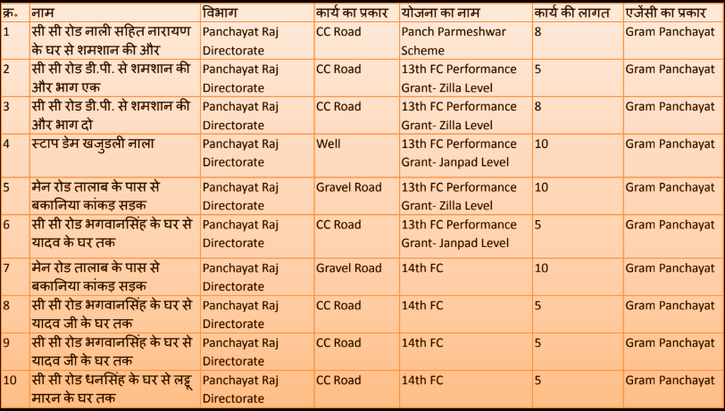
Current GPDP of selected village
No spatial linkage in GPDP. Future land use not envisaged.
Development Control Rules not linked.

Slide 16
Table 1- 2 Observations/modifications suggested in proposed draft RADPFI during the studies conducted for preparation of model village plan
Built up | Use Category | Use category proposed | Activities permitted | Activities proposed to be modified/ added
 | Residential | Residenti al and mixed | Residences* | Residential along with minor commercial activity (daily needs shop, atta chakki, milk selling, dhobi, tea stall, handicraft shop etc)
 | Commercial/ Economic |  | Retail shopping Informal Shop Daily market, weekly, informal , regulated and specialised markets Godowns, Storage grounds | Anaj mandi, petrol pumps, poultry farms, motels, dhaba or restaurants, any other specialized market as per local produce can be listed in this category
 | Utilities and Services |  | Bank, ATM, Credit Society, Police thana, Cremation /Burial ground Crematorium, Community Hall,Dharamshala, Public Toilet, Social Welfare Centre | Waste disposal, water supply, baodies, electric substation and other utilities
 | Special Area |  | Temple, Heritage area, Scenic Value Area, Government Restricted Areas | temple should be replaced by ‘place of worship’

Slide 17
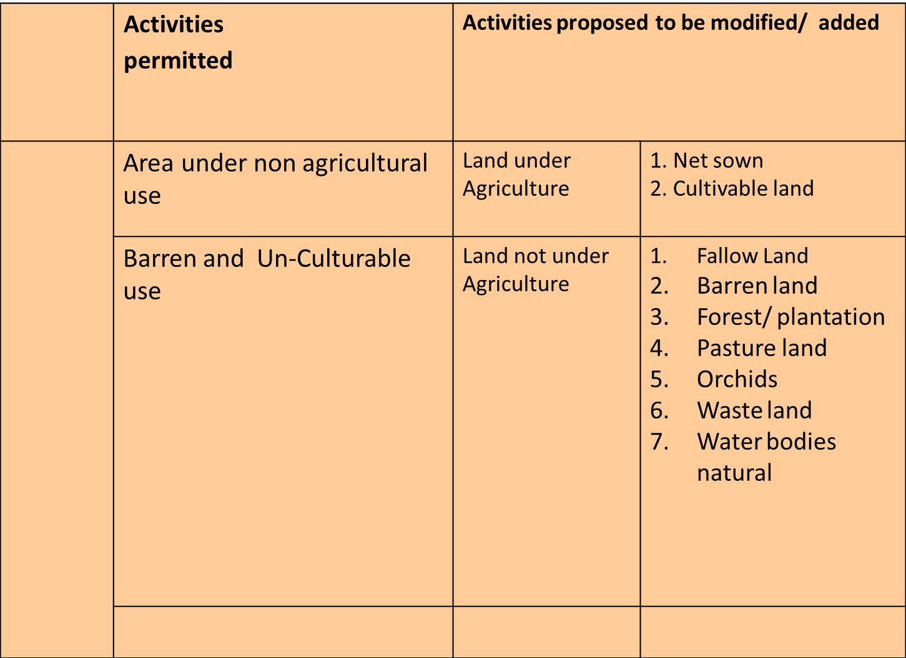
Non- Built Up Area

Slide 18
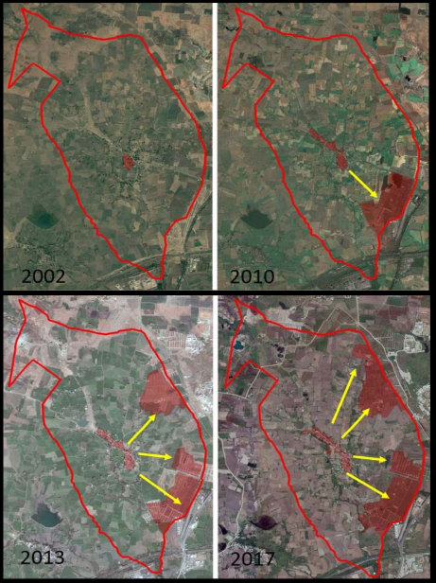
LAYER 1: Evolution of the settlement
Evolution during last 15 yrs (recommended) shown clockwise from 2002 till 2017
Private colonies start emerging around 2010 (after edu hub comes up in neighbourhood)
Inhabited area of village grows in response to the external factors

Slide 19
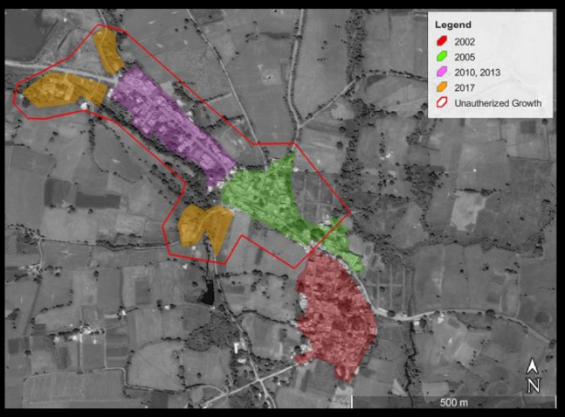
MAP THE TEMPORAL GROWTH OF THE SETTLEMENT AND ESTABLISH ‘EXTENSIONS’ BEYOND RECOGNIZED ABADI AREA

Slide 20
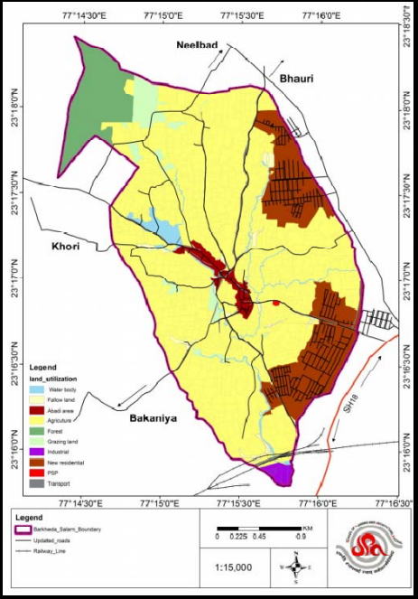
LAYER 2: LAND USE AND BUILT USE
Map overall land use
Land use code decided on the basis of agricultural census and conventional land uses in URDPFI/draft RADPFI guidelines
Land use code may be finalized in consultation with PRD Dept. And/or LR authority of states
Water body
Fallow Land
Abadi Area
Agriculture
Forest
Grazing Land
Industrial
New Residential
PSP
Transport
Barkheda Salam Boundary
Updated Roads
Railways

Slide 21
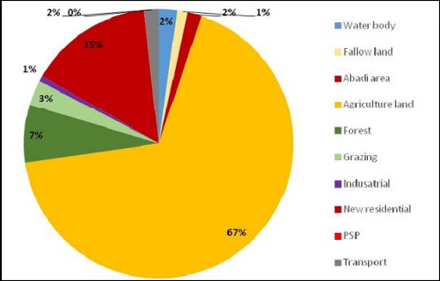
AREA DISTRIBUTION
Abadi area consists of approximately 7% of the total area of Barkheda Salam.
It is located centrally in the village along the main road.
18% of the agricultural land has been converted into residential area which is owned by private developers and builders.
The rest of the 81% of the land is restricted to agricultural activities.

Slide 22
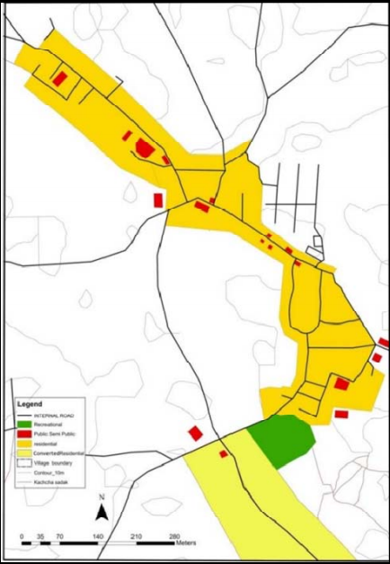
MAP OF ABADI LAND USE
Land Use
Internal Road
Recreational
Public Semi Public
Residential
Converted Residential
Village Boundary
Contour_10m

Slide 23
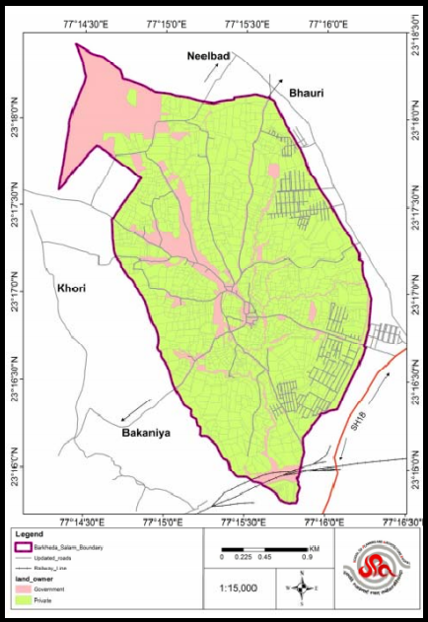
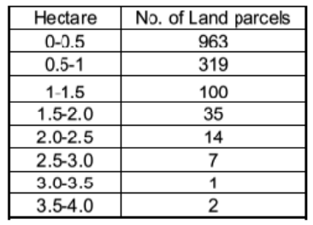
Map land ownership Analyze land holding pattern
Ownership
Government
Private

Slide 24
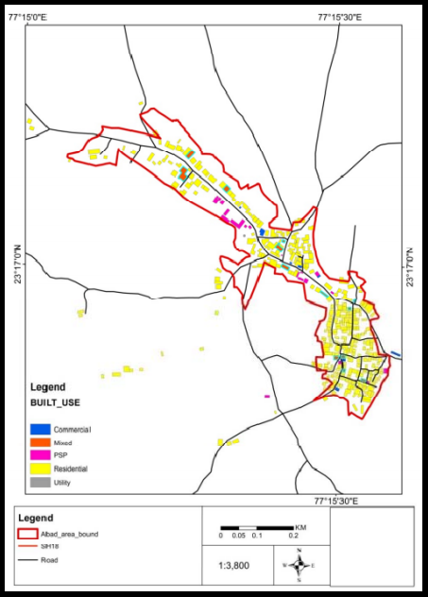
MAP BUILT USE
Built Use
Commercial
Mixed
PSP
Residential
Utility

Slide 25
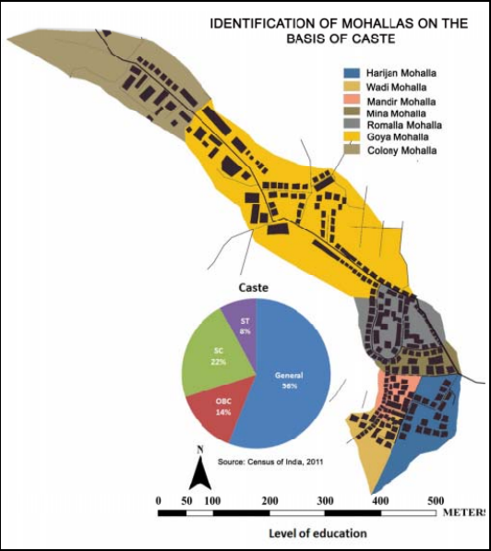
LAYER 3: SOCIO DEMOGRAPHIC ASPECTS
Map relation between settlement and caste/community
Caste
Harijan Mohalia
Wdi ohalia
Mandir Mohalia
Mina Mohalia
Romalia Mohalia
Goya Mohalia
Colony Mohalia

Slide 26
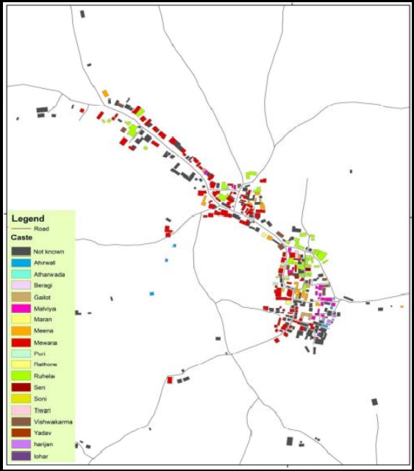
MAP SPATIAL DISTRIBUTION OF HOUSEHOLDS BY CASTE
Caste
Not Known
Ahrwal
Atharwada
Beragi
Gailot
Malviya
Maran
Meera
Mewara
Puri
Rathone
Ruheja
Sen
Soni
Tiwari
ViswaKarma
Yadav
Harijan
Lohar

Slide 27
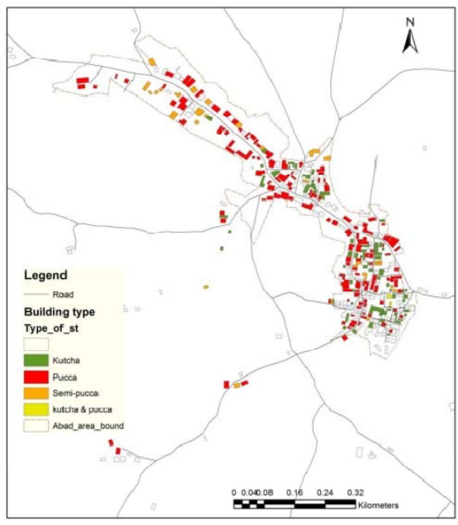
LAYER 4: HOUSING QUALITY
Map spatial distribution of houses by type
Building Type
Kutcha
Pucca
Semi-Pukka
Kutcha and Pucca
Boundary

Slide 28
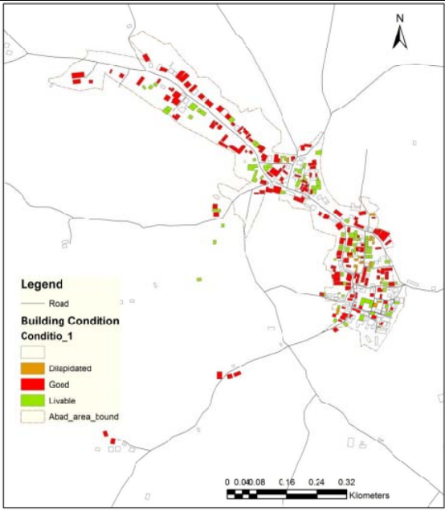
MAP SPATIAL DISTRIBUTION BY CONDITION
Building Condition
Dilapidated
Good
Livable
Abad Area Boundary

Slide 29
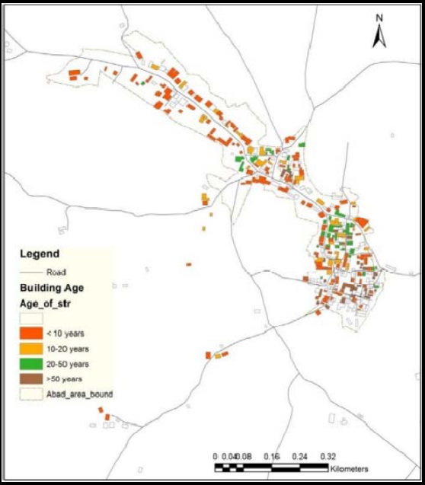
Map spatial distribution of houses by age
Building Age
< 10 years
10 – 20 Years
20 – 50 Years
>50 Years
Abad Area Boundary

Slide 30
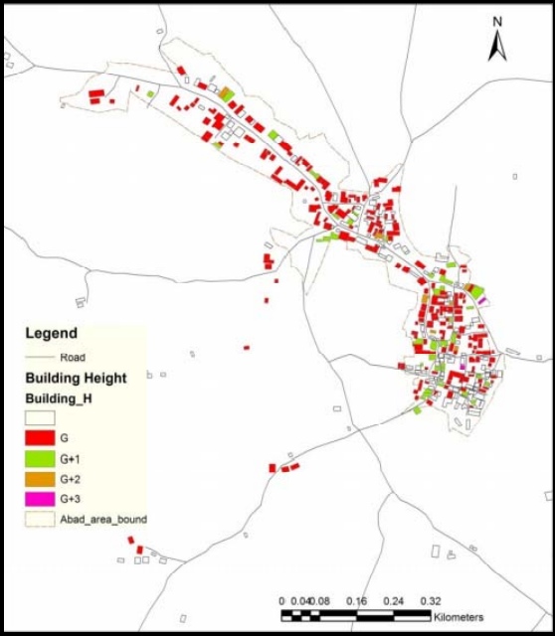
Map spatial distribution of buildings by height
Building Height
G
G+1
G+2
G+3
Abad Area Boundary

Slide 31
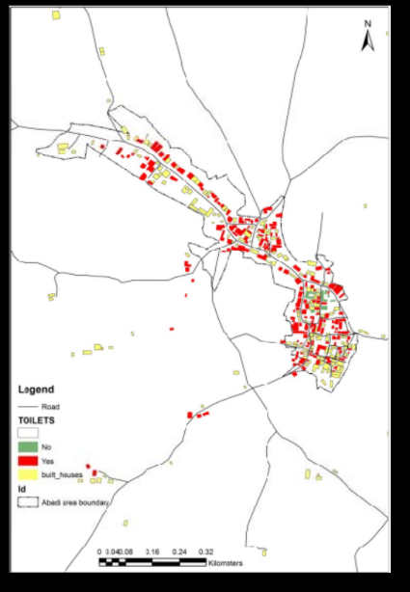
Map toilet availability
Toilets
No
Yes
Built Houses

Slide 32
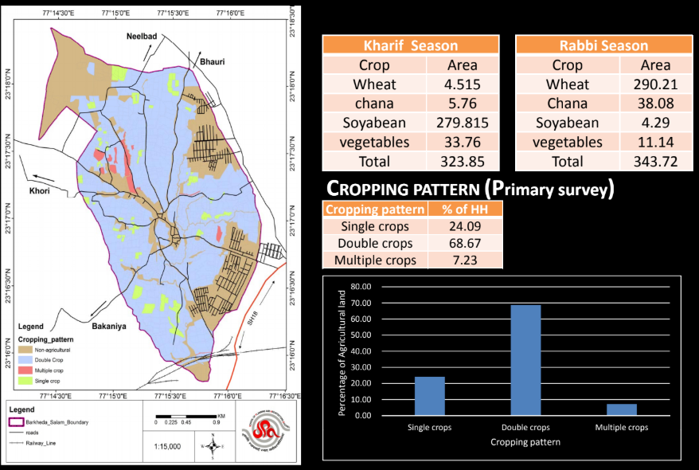
CROPPING PATTERN
Non Agricultural
Double Crop
Multiple Crop
Single Crop

Slide 33
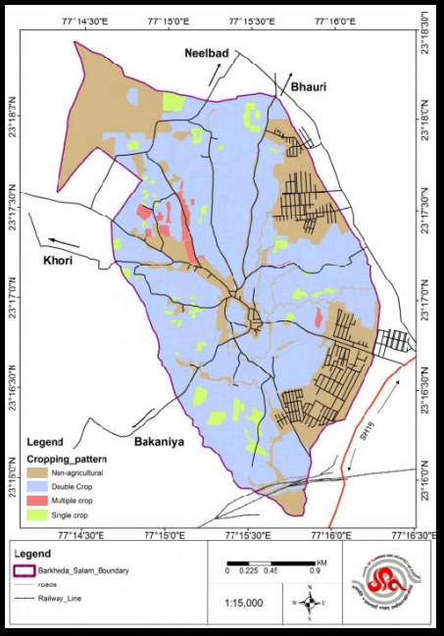
Layer 5: agriculture
Map cropping intensity
Cropping Pattern
Non Agricultural
Double Crop
Multiple Crop
Single Crop

Slide 34
Cropping pattern
Irrigation sources
Livestock

Slide 35
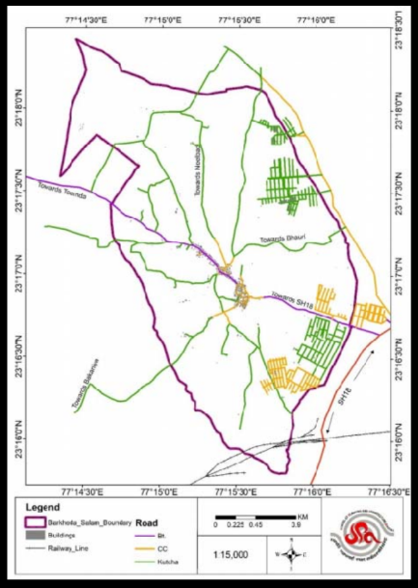
Layer 6:physical infrastructure
Map road network
Connectivity
Barkheda Salam Boundary
Buildings
Railway Line

Slide 36
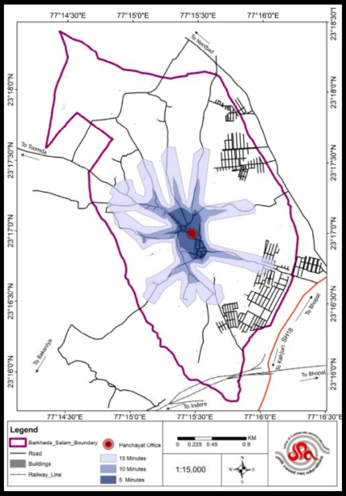
Ped shed analysis
Infrastructure
Barkheda Salam Boundary
Roads
Buildings
Railway Line

Slide 37
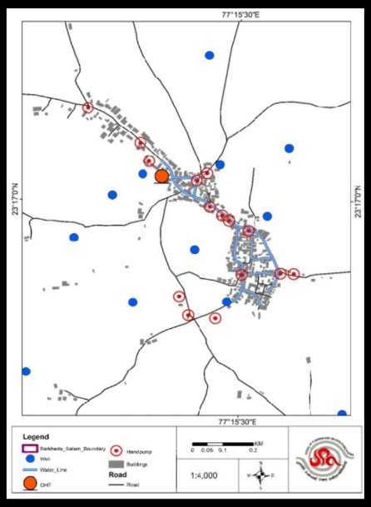
Map water related infrastructure
Infrastructure -water
Barkheda Salam Boundary
Well
Water Line
OHT
Hand Pump
Buidings

Slide 38
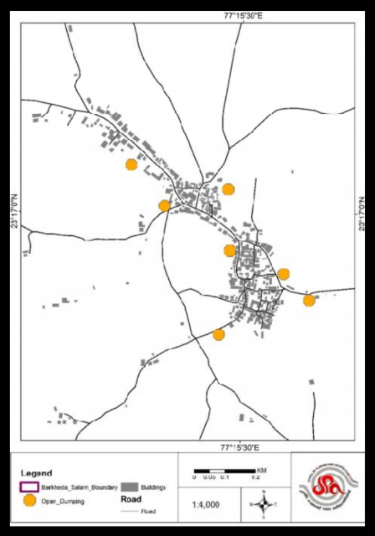
Map open dumping spots
Dumping Spots
Barkheda Salam Boundary
Open Dumping

Slide 39
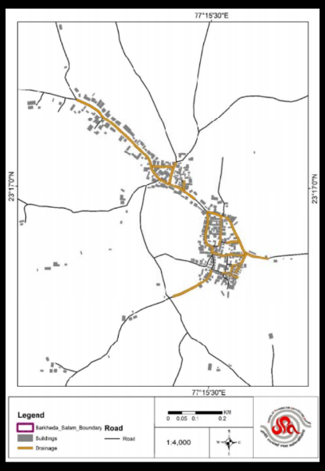
Map drainage pattern
Drainage
Barkheda Salam Boundary
Buildings
Drainage

Slide 40
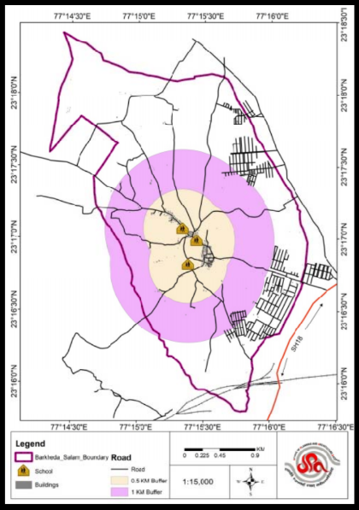
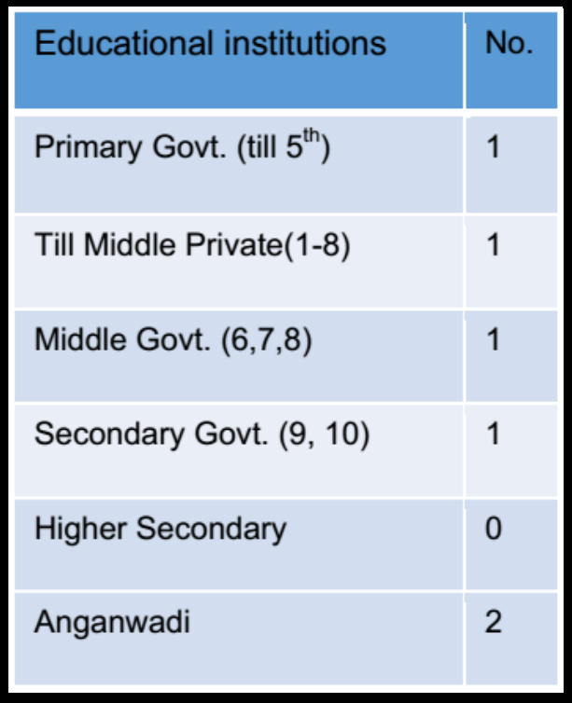
Layer 7: social infrastructure
Location and accessibility of educational facilities
Infrastructure
Barkheda Salam Boundary
School
Buildings
Road
0.5Km
1 Km

Slide 41
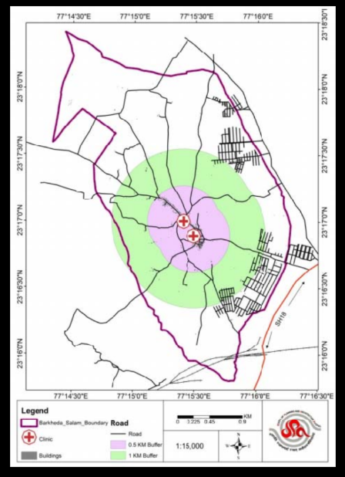
Location and accessibility of health facilities
Health Facilities
Barkheda Salam Boundary
Clinic
Buildings
Road
0.5Km
1 Km

Slide 42
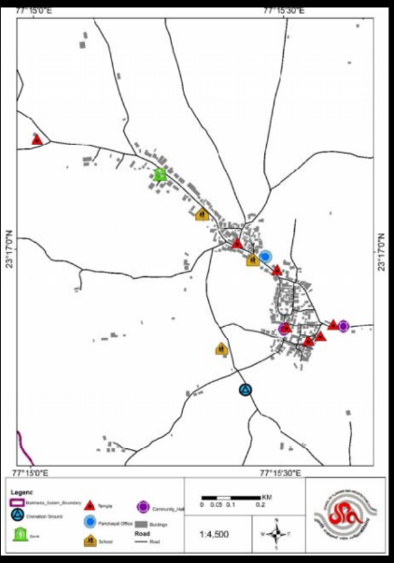
Location and accessibility of other social infrastructure
Social Infrastructure
Boundary
Ground
Bank
Temple
PanchayatOffice
School
Community
Hall
Buildings

Slide 43
Table 4-1: Population Projection
S.No | Population in year
 | Census |  |  | Existing | Projected
Year | 1991 | 2001 | 2011 | 2017 | 2021 | 2023
Population | 1208 | 1533 | 2043 | 2349 | 2521 | 3400

Slide 44
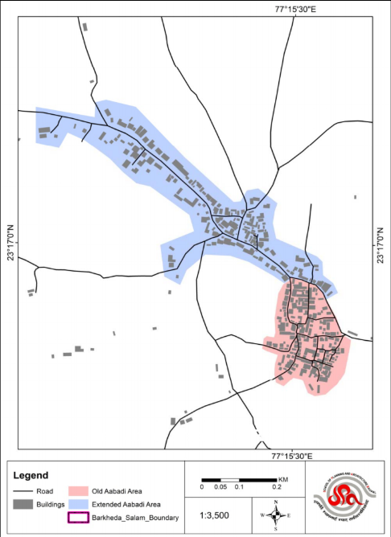
Land allotment
These are government lands which are illegally encroached and villagers have les or no knowledge about the ownership of land. Most of the villages are grown out of the land allotted for Abadi area.
Allotment
Old Abadi Area
Extended Aabadi Area
Barkheda Salam Boundary

Slide 45
Land use
Construction on these land parcels put to residential purpose should be done within one year of conversion or else automatically that land will be registered under agriculture and agriculture activity shall be resumed.
Land banks should be created to be given to landless labourers on lease for cultivation.
Abadi area has been extended on major roads.
Road network should be improved as per proposed plan to reduce the spread of Abadi area.
Present density of village abadi area is 143 and for proposed population projection in 2021 will be 164. Abadi area can easily absorb density of 175 pph with the existing transport network, hence no need to expand the abadi area. However the development along the village road contiguous to the original abadi area needs to be regularized as per the provisions of the M. P. Land Revenue Code.

Slide 46
Colonies/ layouts by SDM as per MP LR code and Madhya Pradesh Gram Panchayat (Registration of Coloniser Terms and Conditions) Rules 1999.
Individual plots by Gram Panchayat as per MP Panchayat Raj Avam Gram Swaraj Adhiniyam 1993

Slide 49
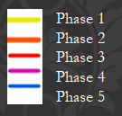
Phase Sector | Phase 1 (2018-19) |  | Phase 2 (2019-20) |  | Phase 3 |  |  | Phase 4 |  | Phase 5
 | Location | Funding Source | Location | Funding Source |  | Location | Funding Source | Location | Funding Source | Location | Funding Source
Desilting of water channels | From large water body to Railway line (2km) (A) | Sarpanch Nidhi/ MNREGS | Sham-A- khal to Land of Mr. Jagannath (1 km) (B) | Sarpanch Nidhi/ MNREGS |  | Sham-A- khal to Land of Mr Kisan Rathore (1/2 km) (C) | Sarpanch Nidhi/ MNREGS | Lower Drain Towards Railway line (1km) (D) | Sarpanch Nidhi/ MNREGS | water body | Sarpanch Nidhi/ MNREGS
Phase wise marking of proposed drainage network plan supported by funding mechanism and converging financial resources through schemes projects and funds
Village Boundary
Waste Stabilization Pond
1 m
Roads
Proposed Drainage

Slide 50
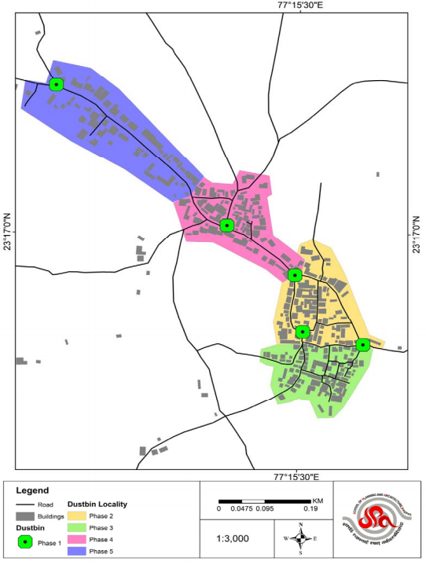
Roads
Buildings
Dust Bin
Dust Bin
Dust Bin Locality
Phase 2
Phase 3
Phase 4
Phase 5

Slide 51
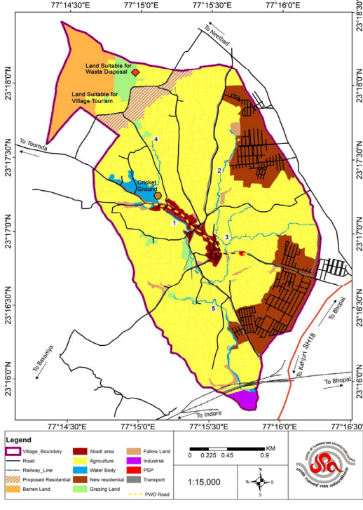
A final Proposed Land use plan compiling all proposals is a must to evaluate the distribution of funds and cumulative spatial implications.
Land Use Plan
Village Boundary
Road
Railway Line
Proposed Residential
Barren Land
Abadi Area
Water Body
Agriculture
New Residential
Grazing Land
Fallow Land
Industrial
PSP
Transport

Slide 52
Information required by planner before preparation of GPSDP
Land ownership
Cropping pattern
Khasra boundaries
Village boundary map
Abadi area boundary
Public infrastructure
Land rates
Flagship rural development programmes of GoI PMAY‐G, SBM‐G, NRLM, NRHM, SSA,
Ownership of road network
Land conversion policies
Funding mechanisms available

Slide 54
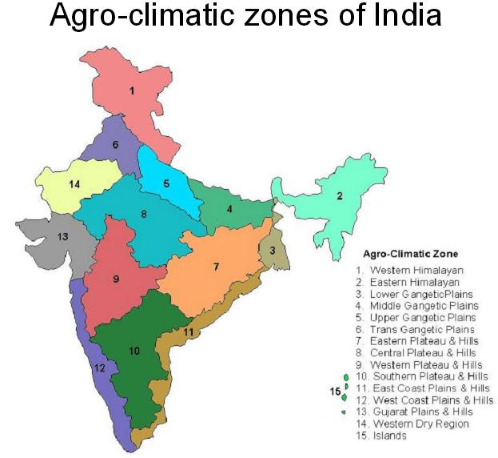
Planning process followed for preparation of this model Gram Panchayat Spatial Development Plan can be followed across the country. The agro climatic variations across the country demands preparation of model plans in each agro climatic zone.

Slide 55
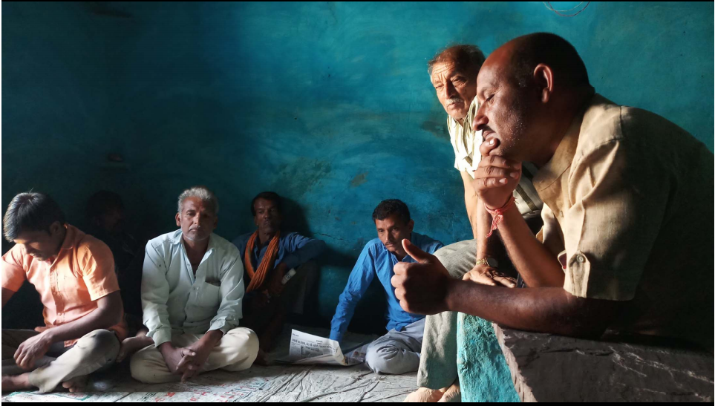
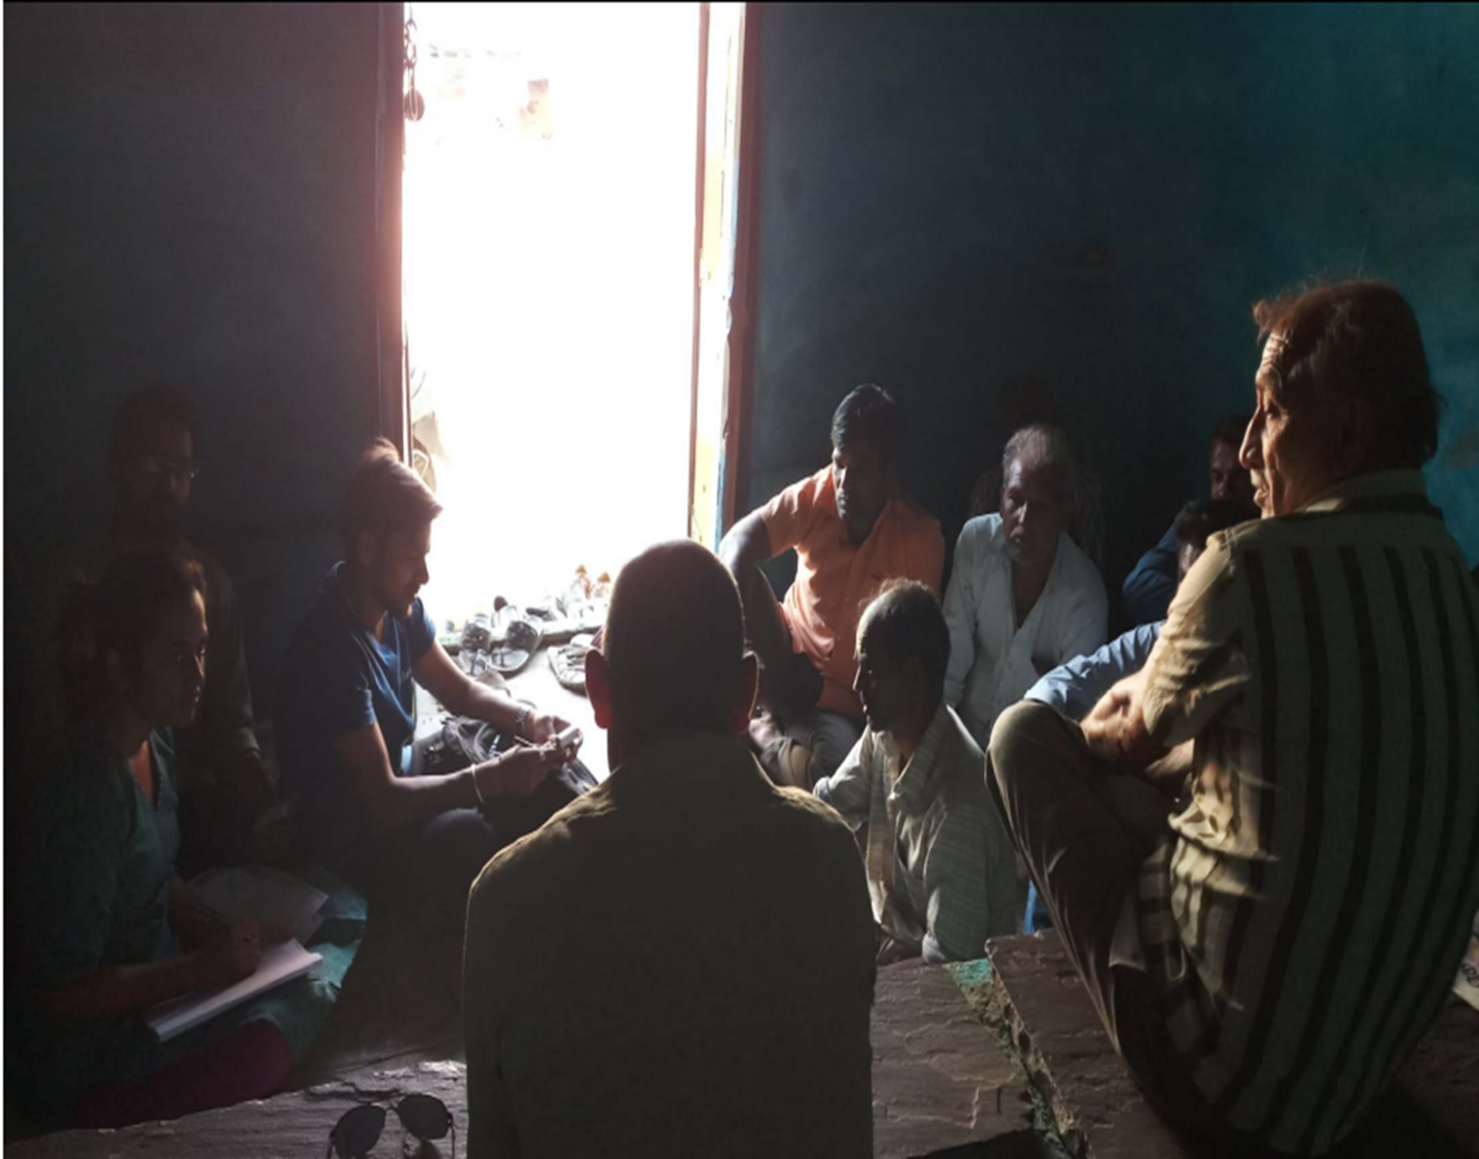

Slide 56
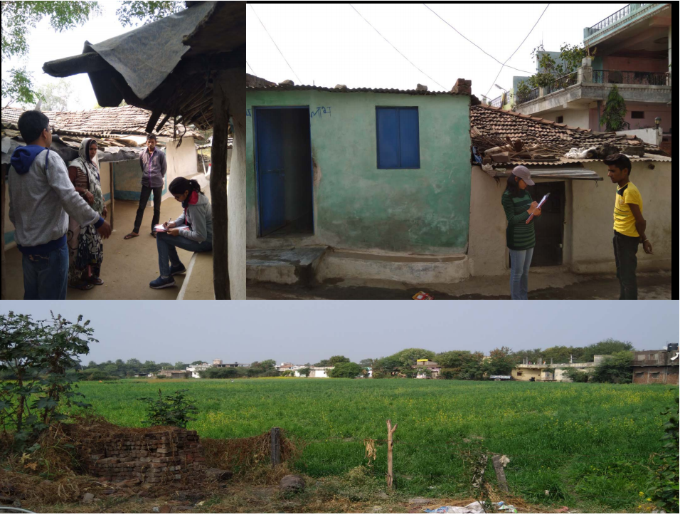

Slide 57
Discussions……………

